Slide 1


FAIR crystallographic data
Brian McMahon
International Union of Crystallography
5 Abbey Square
Chester CH1 2HU, UK
bm@iucr.org

Slide 2
The FAIR principles for crystallographic data
Findable
Accessible
Interoperable
Reusable
Notes:
We enumerate the components of the acronym FAIR and describe in a coarse-grained way how they are applied in crystallography.

Slide 3
The FAIR principles for crystallographic data
Findable
Unique identifiers, descriptive metadata, e.g. DOI
Accessible
Interoperable
Reusable
Notes:
A unique identifier helps to establish that a data set you retrieve is indeed the one that you were looking for. If you have prior knowledge of the unique identifier, then a data set bearing that value is indeed what you wanted. More usually, you will know something about the data set, characterised by a well defined set of metadata terms. A registry system which provides a rich set of metadata terms associated with each unique identifier is a good mechanism for facilitating findability. DOI (digital object identifier) is an appropriate technology, particularly as there is considerable infrastructure for managing DOI registration, update and characterisation. For literature, this is well managed through CrossRef, which has been built on publisher standards for articles extending back many years (arguably centuries). The equivalent system for scientific research data, DataCite, is still evolving its metadata descriptors. Because IUCr journals have long required the deposition of supplementary data sets, structural CIFs and experimental data sets (structure factors, Rietveld profiles) are assigned DOIs within the CrossRef system. The same is true of PDB entries. However, most scientific data will probably be registered with DataCite. There is, however, interoperability between different DOI registration systems.

Slide 4
The FAIR principles for crystallographic data
Findable
Unique identifiers, descriptive metadata, e.g. DOI
Accessible
Data stores addressable through identifiers, descriptive metadata or queries
Interoperable
Reusable
Notes:
In crystallography, we are fortunate to have centralised databases of structural models (and to some extent experimental data sets) – e.g. CSD, COD, ICSD, PDB. The IUCr Diffraction Data Deposition Working Group looked at the prospects for establishing similar repositories for diffraction images, but the size of such data sets makes that unfeasible. More likely is that diffraction images will be stored either on large-scale public repository facilities (e.g. Zenodo) or in experimental facilities or institutional repositories. This will make the findability criteria more important. Note that here I have introduced ‘queries’ alongside ‘metadata’, to suggest that many of the data sets will sit in, or behind, database query engines. To locate data sets spread across federated repositories, the queries will need to be standardised. Actually, ‘queries’ in this sense really are not fundamentally different from metadata descriptors.

Slide 5
The FAIR principles for crystallographic data
Findable
Unique identifiers, descriptive metadata, e.g. DOI
Accessible
Data stores addressable through identifiers, descriptive metadata or queries
Interoperable
Common vocabulary for descriptive metadata and queries
Reusable
Notes:
So, for interoperability, there needs to be a standard vocabulary for the metadata or query terms. Within a domain, this is achievable – it was the original driver for CIF. Across domains it is more of a challenge, but the existence of particular sets of standards (e.g. the CIF dictionaries) provides a good starting point for identifying convergences or divergences of terminology between similar domains.

Slide 6
The FAIR principles for crystallographic data
Findable
Unique identifiers, descriptive metadata, e.g. DOI
Accessible
Data stores addressable through identifiers, descriptive metadata or queries
Interoperable
Common vocabulary for descriptive metadata and queries
Reusable
Standard file format(s)
Notes:
Reusability absolutely demands access to the standard vocabularies, so that the new user/application is confident of the meaning of any data item. It is also greatly facilitated by having a relatively small set of well-defined file formats. Provided there is a standard vocabulary, format conversion is usually relatively straightforward. Within a closed ecosystem, a single file format would be the ideal; but often there are pragmatic reasons why multiple formats need to be supported. Nevertheless, mappings between different formats must be well defined, and are much easier to achieve with standard vocabularies in place.

Slide 7
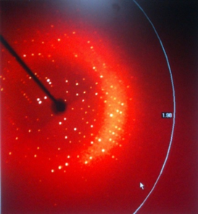
What do we mean by ‘data’?
‘Raw’ data
Numerical data collected directly from an experimental apparatus
Notes:
It’s generally helpful in data-related meetings to define what one means by ‘data’, because there are of course many types of data, and their volume and characteristics require somewhat different approaches in practice. Here I quickly run through the various types of crystallographic data that one might encounter, for two reasons. One is to make the point that they are all relevant to the full scientific record of a piece of research – parts, as it were, of a knowledge continuum. The other is to highlight that the Crystallographic Information Framework, which is the data exchange system developed and promoted by the IUCr, seeks to include all of these types of data, making it particularly useful as a unified model of knowledge representation. The raw data is probably the component that this meeting is most interested in, but it’s worth pointing out that synthetic approaches like CIF are beneficial in reducing the friction in moving along this knowledge spectrum, and that greatly helps the interoperability and reusability aspects of FAIR.

Slide 8
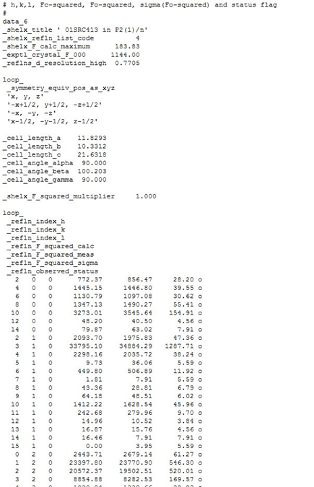
What do we mean by ‘data’?
‘Raw’ data
Numerical data collected directly from an experimental apparatus
‘Processed’ data
Reduced, calibrated, processed numerical observations
Notes:
Typically, processed data (in this sense) are more compact than the raw data captured at the instrument, and thus may lend themselves more readily to archiving for FAIR re-use. IUCr journals provide access to structure factors and Rietveld profiles for non-biological structures. Each data set has a unique DOI, though is not treated as a first-class digital object (i.e. they are “part of” a structural article). The PDB archives structure factors and NMR restraints for each biological structure, though – as far as I am aware – these do not have individual DOIs. The protein structure entries do.

Slide 9
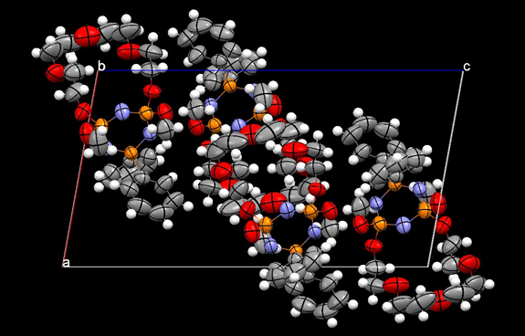
What do we mean by ‘data’?
‘Raw’ data
Numerical data collected directly from an experimental apparatus
‘Processed’ data
Reduced, calibrated, processed numerical observations
‘Derived’ data
Numerical description of the parameters of a calculated structure model
Notes:
Derived data in this context are the molecular or crystal structure models, that in their turn are incorporated into the structural databases. Note that CCDC and the Crystallography Open Database (COD) encourage deposition of structure factors, because these are not always required by non-IUCr journals.

Slide 10
What do we mean by ‘data’?
‘Raw’ data
Numerical data collected directly from an experimental apparatus
‘Processed’ data
Reduced, calibrated, processed numerical observations
‘Derived’ data
Numerical description of the parameters of a calculated structure model
‘Interpretative’ data
Variable parameters in the experimental set-up or numerical modelling and interpretation
Notes:
Typically, what I am calling ‘interpretative’ data are things like constraints and restraints applied during refinement. The CIF project has some difficulty in capturing these in a complete and objective way, since they are often ad hoc devices within particular software implementations. This illustrates the desirability (perhaps need) for archiving software alongside data and literature – fraught with problems, of course, because of machine dependencies, languages, supporting libraries – but also encourages research into capturing and/or defining algorithmic methods. [In a very modest way, DDLm/dREL may be the start of thinking about this in a general way.]

Slide 11
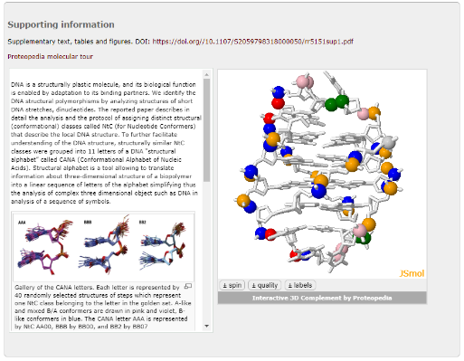
What do we mean by ‘data’?
‘Raw’ data
Numerical data collected directly from an experimental apparatus
‘Processed’ data
Reduced, calibrated, processed numerical observations
‘Derived’ data
Numerical description of the parameters of a calculated structure model
Annotation
‘Interpretative’ data
Variable parameters in the experimental set-up or numerical modelling and interpretation
Notes:
Annotation includes descriptive relationships between subsets of the included structural and experimental data (automatically or manually-generated; the example shown is a Protopedia molecular tour served as supporting information to a journal article). Providing this type of functionality is much easier for the sort of comprehensive data description systems like CIF that can treat numerical data and classical ‘metadata’ on a similar footing.

Slide 12
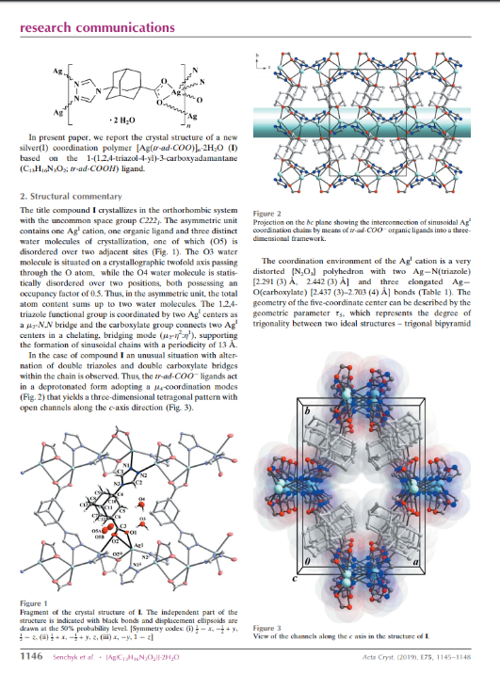
What do we mean by ‘data’?
Commentary
‘Raw’ data
Numerical data collected directly from an experimental apparatus
‘Processed’ data
Reduced, calibrated, processed numerical observations
‘Derived’ data
Numerical description of the parameters of a calculated structure model
Annotation
‘Interpretative’ data
Variable parameters in the experimental set-up or numerical modelling and interpretation
Notes:
Commentary refers in our context to a publication in the traditional scientific literature. It’s an extension of the ‘annotation’ idea, where links to related literature, data sets or other external objects are incorporated into the host data set. This is a good model of where you want FAIR practice to be able to take you to.

Slide 13
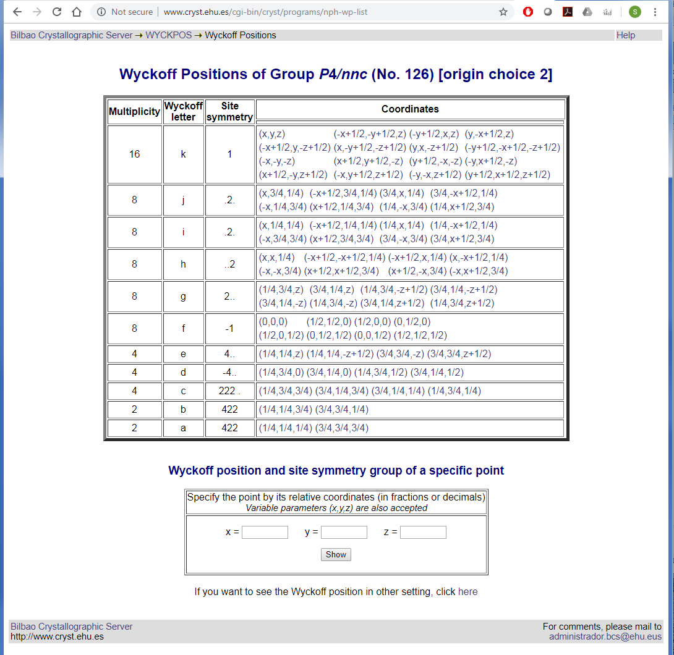
What do we mean by ‘data’?
Commentary
‘Raw’ data
Numerical data collected directly from an experimental apparatus
‘Processed’ data
Reduced, calibrated, processed numerical observations
‘Derived’ data
Numerical description of the parameters of a calculated structure model
‘Reference’ data
Annotation
‘Interpretative’ data
Variable parameters in the experimental set-up or numerical modelling and interpretation
Notes:
Examples of reference data are the symmetry relationships stored in the Bilbao Crystallographic Server (shown here), the PDB ligand database, compilations of bond valence parameters etc. Many reference databases are, or include, compilations of discrete data sets. A good example of the way this all comes together is that the database schema for the PDB itself is, essentially, the mmCIF dictionary, which was developed as a mechanism for describing a single structure and its component parts.

Slide 14
Benefits of Crystallographic Information Framework
Interoperable across all types of crystallographic data
Notes:
Here we describe some of the architectural features that have made CIF a solid basis for developing FAIR practices in crystallography. First is that it was designed to be generic and extensible, so that it could be applied across any type of data involved in crystallographic research.

Slide 15
A coherent information flow
Raw experimental data (e.g. diffraction images)
Reduced/processed data (e.g. structure factors)
Derived data (e.g. coordinates, a.d.p.s)
Chemistry databases
(e.g. CCDC)
IUCr journals
Experiment
(facility or laboratory)
Data reduction
Structure solution and refinement
(laboratory)
Biological structure databases
(e.g. PDB)
Other journals
retained by scientist
archived at facility (~6 months)
deposited
published/disseminated
validated
Notes:
This rather well known schematic demonstrates the use of CIF at every stage from experimental station through structure solution, validation, publication and database deposition. In practice CIF format files are not involved at every point along this trajectory (e.g. HDF5/NeXus in the experimental facilities, Word documents in some variants of the publication process), but all the necessary data items can be characterised by terms defined in CIF dictionaries.

Slide 16
Benefits of Crystallographic Information Framework
Interoperable across all types of crystallographic data
Treats ‘metadata’ and ‘data’ on same footing
Notes:
There is no formal distinction between items that might be characterised as metadata and those that are categorised as data. This facilitates the flexibility and widespread applicability of CIF. For applications that do use the CIF format consistently, it can facilitate software development, because a single parser can handle any content in a CIF file (even if just by ignoring items not relevant to the current application).

Slide 17
Benefits of Crystallographic Information Framework
Interoperable across all types of crystallographic data
Treats ‘metadata’ and ‘data’ on same footing
Establishes a common file format
Notes:
The use of a standard file format along the ‘coherent information flow’ can make software systems (and workflows) easier to write and maintain. It’s not essential – as we have seen in practice, HDF5/NeXus is increasingly common at the raw data end. Even so, it raises the possibility say of retaining a subset of collected images to be converted to imgCIF/CBF format for archive purposes. Anyway, the point to be made is that the existence of a common file format is a useful facilitator, but not an essential requirement for applications to interoperate within the broader CIF framework. Too much time and effort has been spent in the past in format ‘holy wars’.

Slide 18
Benefits of Crystallographic Information Framework
Interoperable across all types of crystallographic data
Treats ‘metadata’ and ‘data’ on same footing
Establishes a common file format
(more or less: DDL1/DDL2/DDLm ‘dialects’; CBF as binary equivalent of imgCIF; CIF1 vs CIF2 syntax)
Notes:
Even within the CIF syntax specifications, there is room for some variation in format, either to accommodate strict relational data models or to allow binary data compression. Nevertheless, controlled variation within a small compass allows for the development of generic software tools and libraries.

Slide 19
Benefits of Crystallographic Information Framework
Interoperable across all types of crystallographic data
Treats ‘metadata’ and ‘data’ on same footing
Establishes a common file format
(more or less: DDL1/DDL2/DDLm ‘dialects’; CBF as binary equivalent of imgCIF; CIF1 vs CIF2 syntax)
(but that’s not too important because the data structures, types etc. are well defined)
Notes:
And, again, format interconversion, though often a nuisance, is not really a killer if there are wider benefits to be gained from maintaining specialised formats for certain purposes.

Slide 20
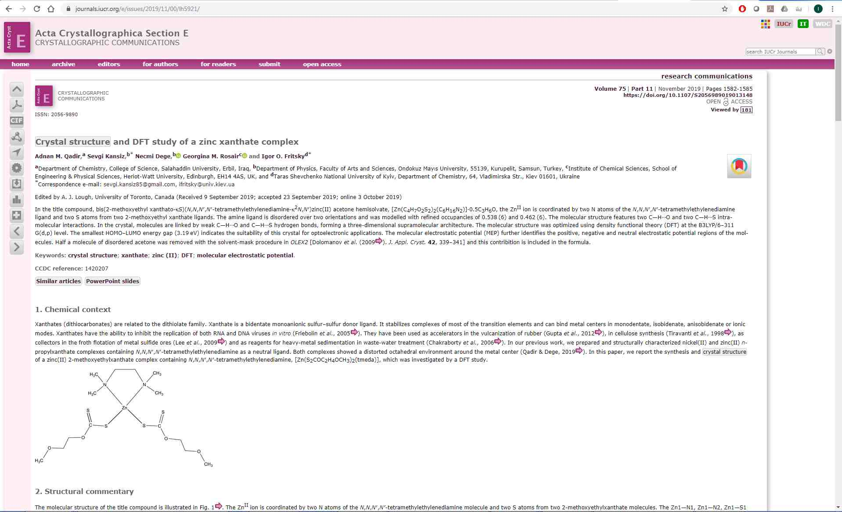
Varieties of data managed by CIF in IUCr publications
Small unit-cell structures:
submitted as CIF
include article text (commentary)
Notes:
Here are a few slides simply to illustrate how well CIF handles the various types of data in the particular field of publication. In some IUCr journals (Acta Crystallographica Sections B, C, E and IUCrData) the entire text of an article can be submitted as a CIF file (it is actually the only format supported by Acta E and IUCrData). This is the ‘commentary’ type of data in our earlier slides.

Slide 21
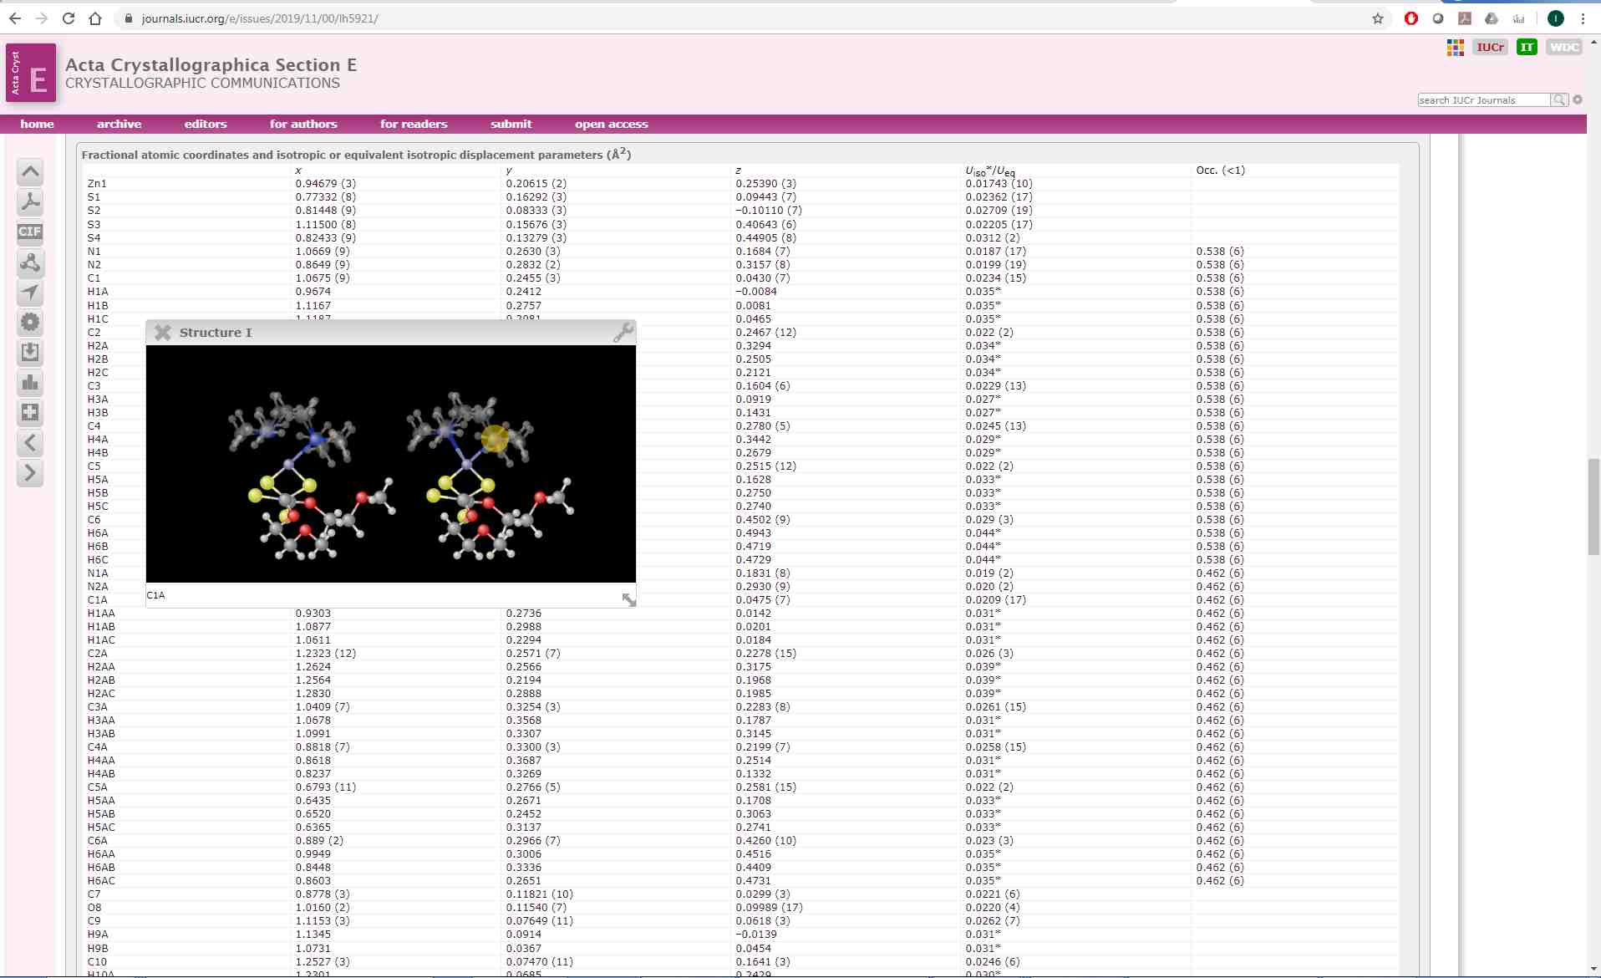
Varieties of data managed by CIF in IUCr publications
Small unit-cell structures:
submitted as CIF
include article text (commentary)
structural model (derived data)
annotation (visualise individual positions, bonds)
Notes:
Structural data supporting any small-unit-cell structure reported in IUCr journals must be sent in a CIF file (either the submission file for structure reports journal, or an accompanying ‘supporting information’ file). In some of our journals there is limited application of the notion of ‘annotation’ data (internal hyperlinks relating displayed text with additional information, as illustrated here), and there is also the ability to interact directly with the numeric data in an article (e.g. 3-D visualisation using an application like JSmol). There is also a prototypical JSmol editor to allow authors to create annotated 3-D views of aspects of the structure.

Slide 22
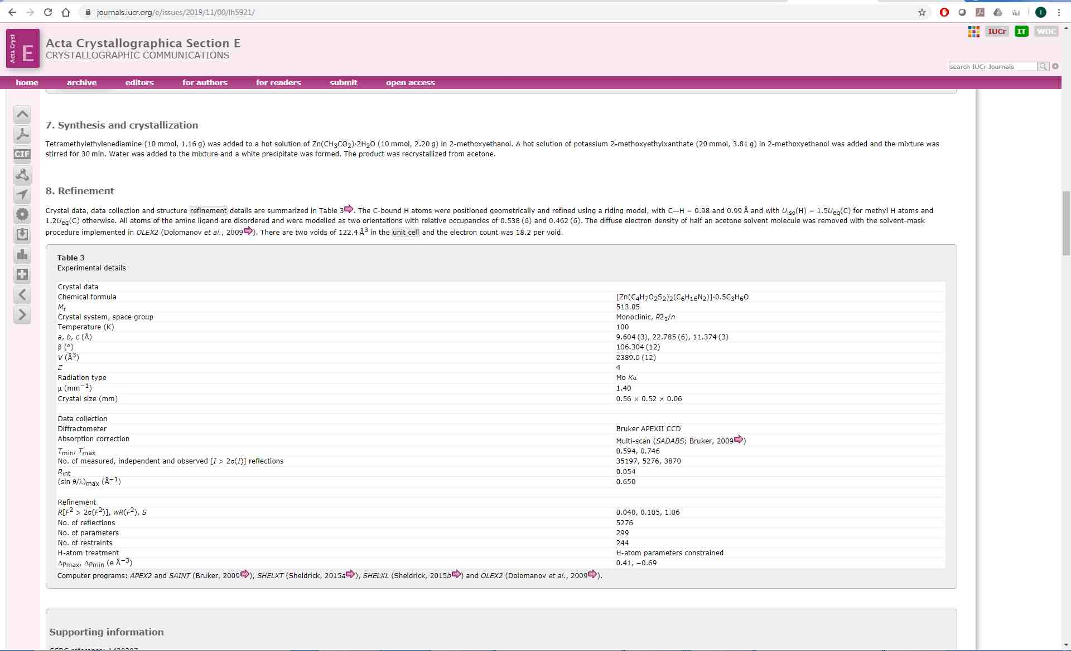
Varieties of data managed by CIF in IUCr publications
Small unit-cell structures:
submitted as CIF
include article text (commentary)
structural model (derived data)
annotation (visualise individual positions, bonds)
experimental details (‘metadata’)
Notes:
As emphasised before, ‘metadata’ in the sense of descriptions of the experimental procedures are embedded integrally within the CIF, and so experimental tables can be formatted automatically for publication (that relieves authors of a lot of labour!).

Slide 23
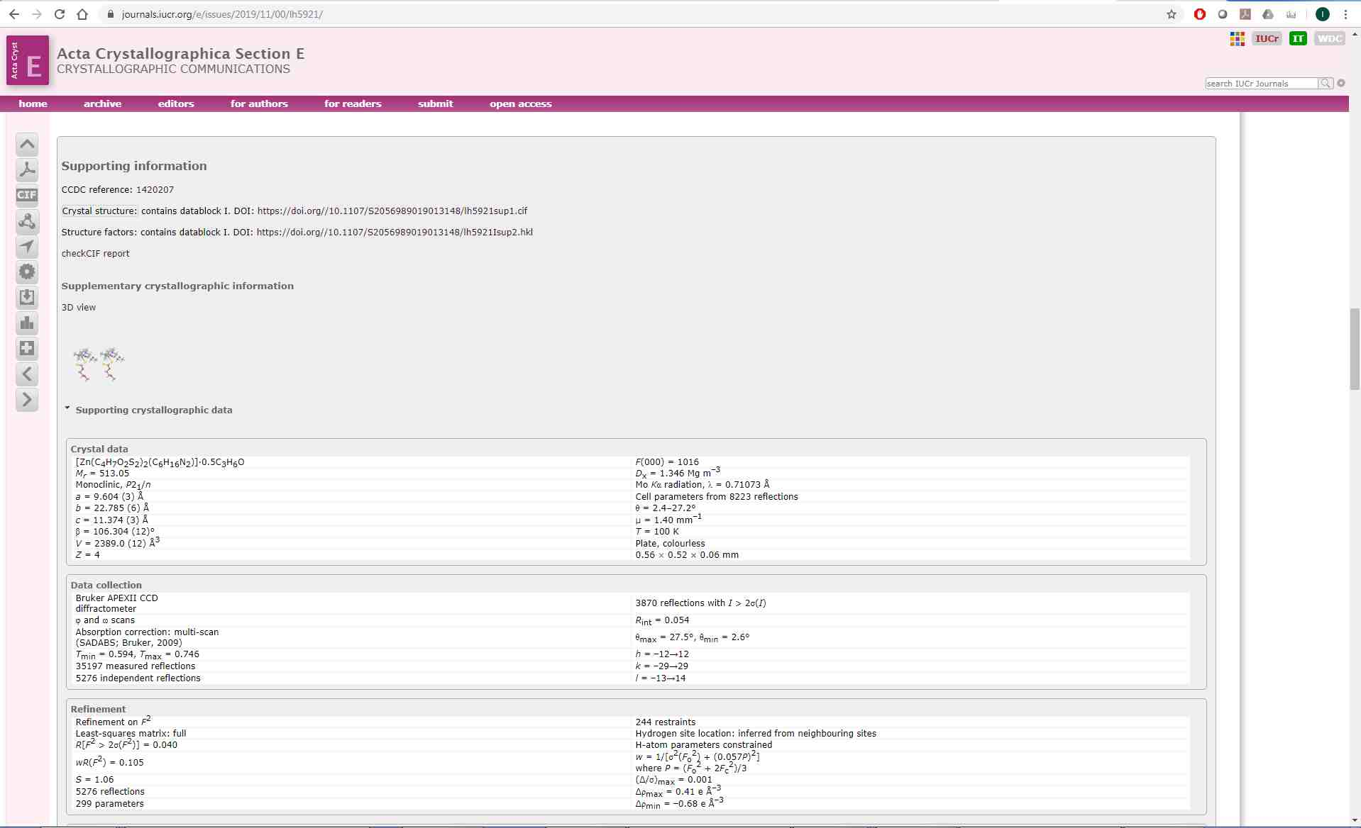
Varieties of data managed by CIF in IUCr publications
Small unit-cell structures:
submitted as CIF
include article text (commentary)
structural model (derived data)
annotation (visualise individual positions, bonds)
experimental details (‘metadata’)
experimental (processed) data
Supporting information includes
structural data and processed experimental data sets, each identified by distinct DOIs
Notes:
Processed experimental data, such as structure factors or powder profiles, are also handled easily in CIF format. For IUCr journals (though not necessarily for journals of other publishers), such supporting data are mandatory for small-unit-cell structures. Structure factors are also mandated for PDB deposition of biological macromolecular structures.

Slide 24
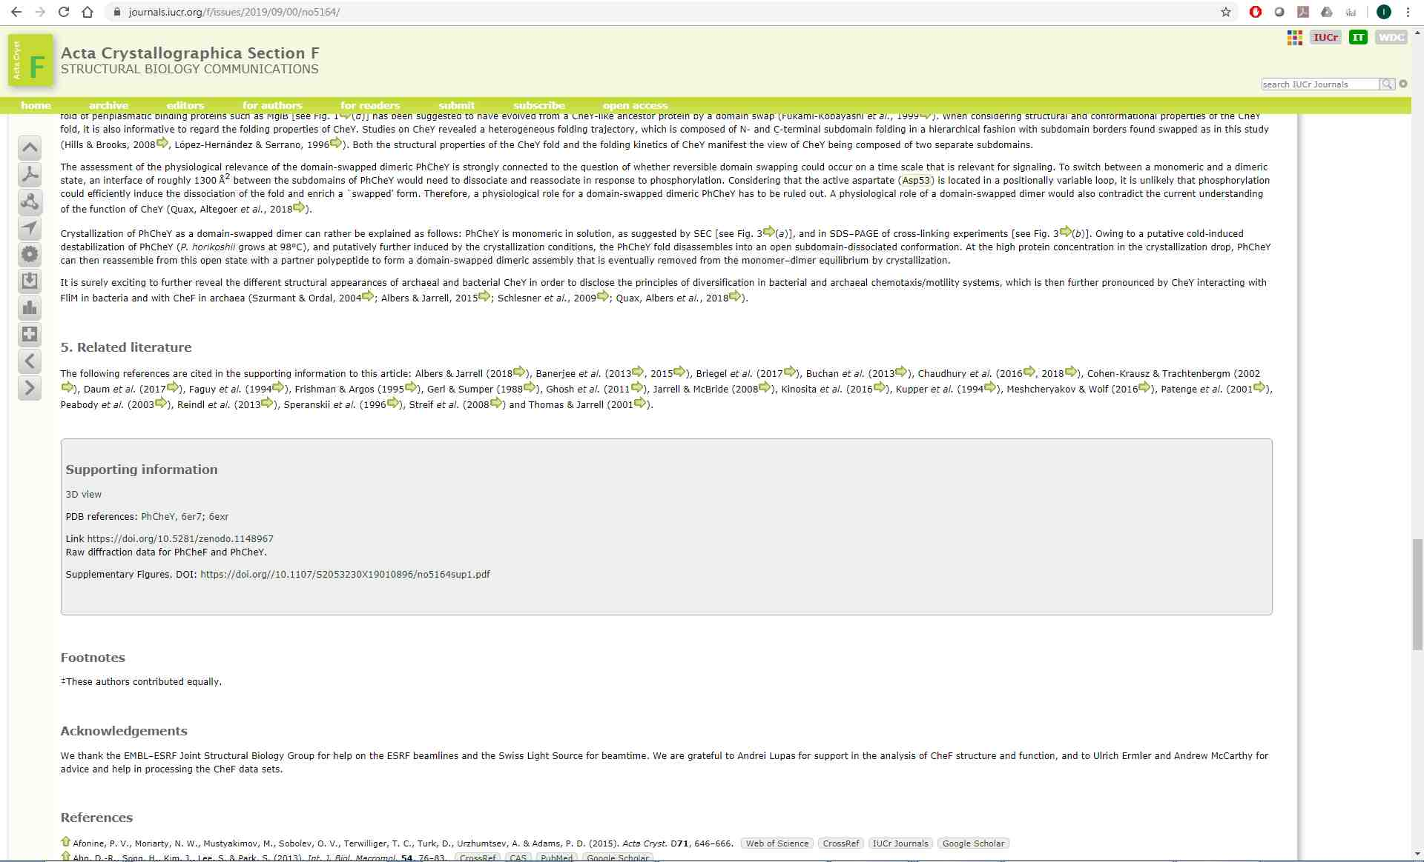
Varieties of data managed by CIF in IUCr publications
Macromolecular structures:
most of the same features as small-cell structures
links to raw diffraction data sets
Links to external raw data sets are provided; DOIs are preferred identifiers
Notes:
Following the IUCr DDDWG/CommDat efforts, public deposition of raw image data sets is actively encouraged for biological macromolecular structures (and supported in the case of small-unit-cell structures, though this community does not yet regularly do so).

Slide 25
Benefits of Crystallographic Information Framework
Interoperable across all types of crystallographic data
Treats ‘metadata’ and ‘data’ on same footing
Establishes a common file format
(more or less: DDL1/DDL2/DDLm ‘dialects’; CBF as binary equivalent of imgCIF; CIF1 vs CIF2 syntax)
(but that’s not too important because the data structures, types etc. are well defined)
Has precisely defined data items
Notes:
However, underlying all these benefits and extensible to other data transmission mechanisms is the fact that CIF data items are formally and precisely collected and defined by community-based expert groups. These machine-readable ‘ontologies’ (controlled vocabularies, defined physical units and acceptable ranges of values, interrelationships) form the basis for functional interoperability between diverse file formats and software implementations, within any crystallographic or related field.

Slide 26
Data definitions in CIF ‘dictionaries’
Managed by COMCIFS
Crystallographic Core (coreCIF) – 1991 and ongoing
Crystallographic Restraints – 2011
Crystallographic Powder Diffraction (pdCIF) – 1997
Modulated and Composite Structures (msCIF) – 2002
Multipole Electron Density (rhoCIF) – 2003
Crystallographic Twinning – 2014
Magnetic Structures (magCIF) – 2016
Lattice topology (topoCIF) – 2018
Crystallographic Symmetry (symCIF) – 2001
Diffraction Images (imgCIF) – 2000
High pressure – under development
Crystallographic Macromolecular Structure (mmCIF) – 1997
Managed by wwPDB
Crystallographic Macromolecular Structure (mmCIF) – 1997
PDB Exchange Dictionary (PDBx/mmCIF) – 1997 and ongoing
Integrative/Hybrid (I/H) methods – 2017
3DEM Extension Dictionary – 2004
NMRSTAR Dictionary – 2013
Biological Small Angle Scattering – 1998
Model Archive Extension Dictionary – 2018
BIOSYNC Extension Dictionary – 2000
NMR Exchange Format Dictionary – 2016
Notes:
This is the current list of distinct dictionaries openly available to the crystallographic community. There are also some local dictionaries (for specific software applications or database implementations), and a growing number of comparable dictionaries in other similar fields (materials science, biological NMR structures).

Slide 27
Example of a data item definition
save__diffrn_radiation.polarizn_source_norm
_item_description.description
; The angle in degrees, as viewed from the specimen, between the normal to the polarization
plane and the laboratory Y axis as defined in the AXIS category.
Note that this is the angle of polarization of the source photons, either directly from a
synchrotron beamline or from a monchromator.
This differs from the value of _diffrn_radiation.polarisn_norm in that
_diffrn_radiation.polarisn_norm refers to polarization relative to the diffraction plane
rather than to the laboratory axis system.
In the case of an unpolarized beam, or a beam with true circular polarization, in which
no single plane of polarization can be determined, the plane should be taken as the XZ
plane and the angle as 0.
See _diffrn_radiation.polarizn_source_ratio.
;
_item.name '_diffrn_radiation.polarizn_source_norm'
_item.category_id diffrn_radiation
_item.mandatory_code no
loop_
_item_range.maximum
_item_range.minimum 90.0 90.0
90.0 -90.0
-90.0 -90.0
_item_type.code float
_item_units.code degrees
_item_default.value 0.0
save_
Notes:
This is an example, chosen pretty much at random from the imgCIF dictionary, to demonstrate the machine-readable attributes associated with a data item definition, and also to indicate the level of precision that is present in many definitions. The goal is to eliminate (or at least minimize) scope for ambiguity or error in sharing data between different applications.

Slide 28
How this might appear in a data file
data_image_1
# category DIFFRN
_diffrn.id P6MB
_diffrn.crystal_id P6MB_CRYSTAL7
# category DIFFRN_SOURCE
loop_
_diffrn_source.diffrn_id
_diffrn_source.source
_diffrn_source.type
P6MB synchrotron 'SSRL beamline 9-1'
# category DIFFRN_RADIATION
loop_
_diffrn_radiation.diffrn_id
_diffrn_radiation.wavelength_id
_diffrn_radiation.monochromator
_diffrn_radiation.polarizn_source_ratio
_diffrn_radiation.polarizn_source_norm
_diffrn_radiation.div_x_source
_diffrn_radiation.div_y_source
_diffrn_radiation.div_x_y_source
P6MB WAVELENGTH1 'Si 111' 0.8 0.0 0.08 0.01 0.00
# category DIFFRN_RADIATION_WAVELENGTH
loop_
_diffrn_radiation_wavelength.id
_diffrn_radiation_wavelength.wavelength
_diffrn_radiation_wavelength.wt
WAVELENGTH1 0.98 1.0
# category DIFFRN_DETECTOR
loop_
_diffrn_detector.diffrn_id
_diffrn_detector.id
_diffrn_detector.type
_diffrn_detector.number_of_axes
P6MB MAR345-SN26 'MAR 345' 4
Notes:
Just a very brief example of how the data appear in a CIF format file. The data items are clearly labelled with the data name (as defined in the associated dictionary). The format is lightweight, easily machine-readable and can be laid out in a way that makes it easy for humans to read (though the layout is not rigid, and the contents could be packed more densely if desired). Conversion of this format to any other tag, value paradigm (e.g. XML) is very straightforward.

Slide 29
The CIF-NeXus concordance
Use of imgCIF dictionary as basis for a NeXus MX profile
Collaboration between COMCIFS and NIAC
Facilitation meeting at COMCIFS workshop, U. Warwick, 2013
Herbert J. Bernstein, Tobias Richter et al.
Ongoing project
HDRMX meetings to establish essential metadata for high-data rate macromolecular crystallography
Notes:
A very specific example of interoperability with the CIF framework is the concordance established between a COMCIFS Working Group and the NeXus International Advisory Committee over the last few years, to equivalence CIF data names with tags in the NeXus macromolecular crystallography profile, and to help extend the tag sets in both formalisms as required by the community.

Slide 30
CBF, NeXus/HDF5 Interaction
CBF remains CBF, NeXus remains NeXus
Interoperablity lets either be used when needed
New dictionaries and extensions to existing dictionaries help in documenting mappings
Applications gain from extension to the APIs, starting with CBFlib
HDF5 and NeXus users gain CBFlib compressions
CBF users gain HDF5 compressions
Acknowledgement: H. J. Bernstein, DDDWG Workshop, Rovinj, 22-23 August 2015
Notes:
Major features of the CIF-NeXus interaction, as listed by Herbert Bernstein in his presentation to the DDDWG Workshop on Metadata.

Slide 31
IUCr bodies related to data standards
COMCIFS (Committee for the Maintenance of the CIF Standard)
1993-
DDDWG (Diffraction Data Deposition Working Group)
2011-2017
CommDat (Standing Committee on Data)
2017-
Notes:
In recent years three IUCr bodies have taken particular interest in data standards. There have also been transient committees charged with oversight of the curated crystallographic databases, and a previous Commission on Crystallographic Data; these responsibilities now fall under the purview of CommDat.

Slide 32
DDDWG 2011-2017
IUCr Working Group on Diffraction Data Deposition
Chair: John R. Helliwell
Terms of reference: ‘lead the development of standards for the representation of data and associated metadata that can lead to the routine deposition of raw data’
Workshops:
Workshop at ECM-27, Bergen: August 6 2012
Workshop at ECM-29, Rovinj: August 22-23 2015 (metadata)
Workshop at ACA 2017, New Orleans: May 26 2017
http://www.iucr.org/resources/data/dddwg
Notes:
The DDDWG was particularly effective in establishing the role of raw data deposition (and to some extent standardisation) particularly in structure solution by X-ray diffraction methods, but with some awareness of other experimental data types and methodologies.

Slide 33
DDDWG approach
Careful analysis of technical requirements (articles in Acta Cryst.)
Canvassing of community views
Engagement of IUCr Commissions
Biological structures community initially conservative
Structure factors mandatory for PDB depositions
Possible interest in unmerged structure factors
However, over lifetime of DDDWG, interest grew
Working repositories (Store.Synchrotron; IRRMC, SBGrid)
Chemical crystallographers now being consulted

Slide 34
DDDWG final recommendations (17 in all!)
Authors should provide a permanent and prominent link from their article to the raw data sets which underpin their journal publication and associated database deposition of processed diffraction data (e.g. structure factor amplitudes and intensities) and coordinates, and should obey ‘FAIR’ principles (Findable, Accessible, Interoperable and Re-usable https://www.force11.org/group/fairgroup/fairprinciples)
A registered Digital Object Identifier (DOI) should be the persistent identifier of choice (rather than a URL) as the most sustainable way to identify and locate a raw diffraction data set.
An archive of raw diffraction data sets for currently unsolved crystal structures should be pursued.
An archive of raw diffraction data sets showing significant diffuse scattering should be pursued.
Workshops for research data management training for the community should continue and be sponsored and organised by the IUCr.
There should be continued regular checking by the IUCr Executive Committee of the progress of the IUCr Commissions logging of their raw diffraction data metadata.
Notes:
These are (perhaps) the most significant of the DDDWG’s final recommendations. The first two have resulted in recommendations in IUCr biological structure journals encouraging authors to deposit and provide access to raw data sets.

Slide 35
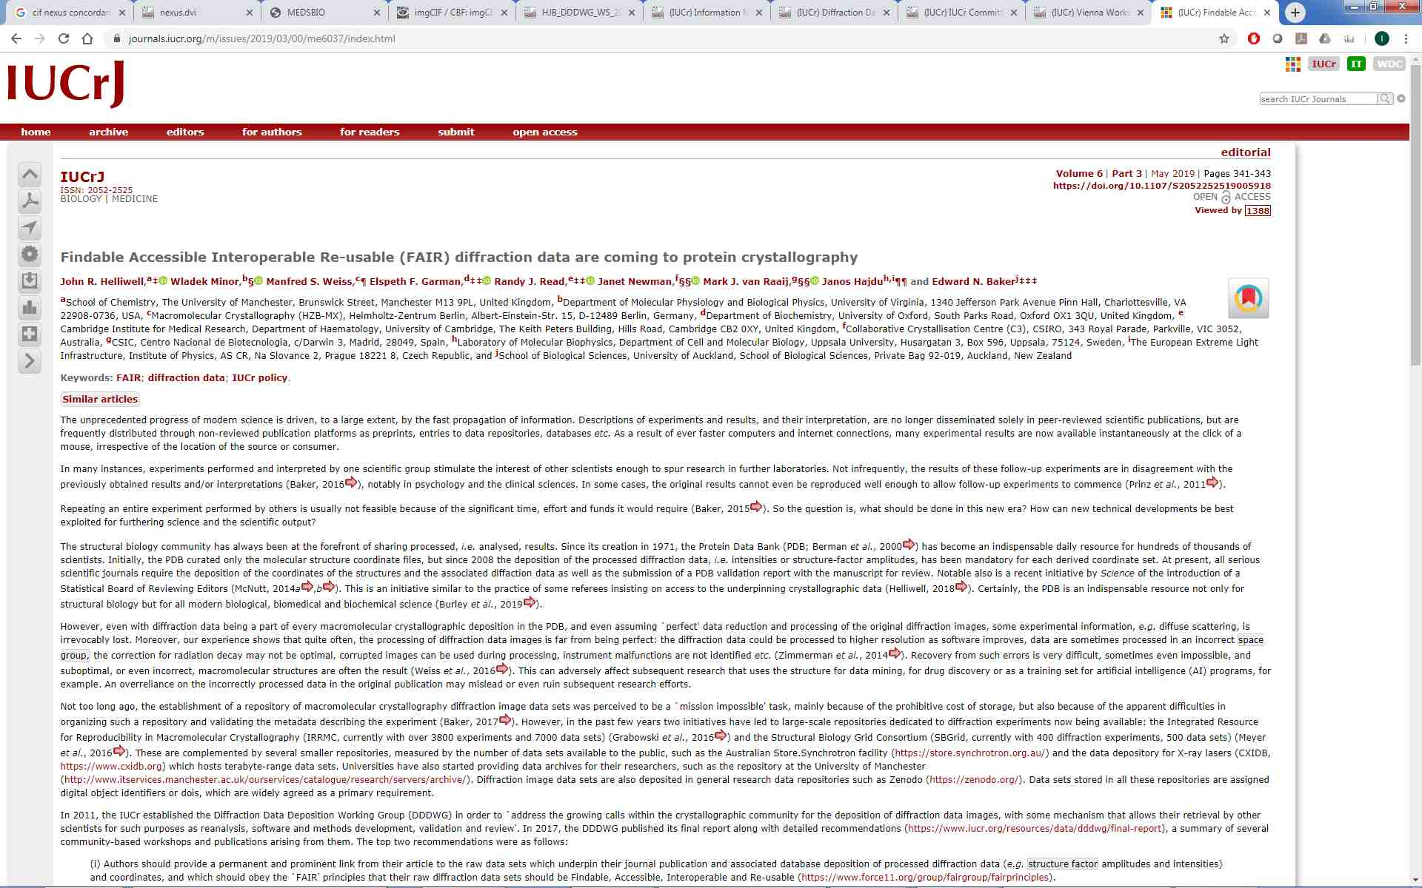
CommDat/Commission on Biological Macromolecules journals initiative
“IUCr Journals are now taking the lead by encouraging authors to provide a DOI for their deposited original raw diffraction data when they submit an article describing a new structure or a new method tested on unpublished diffraction data. In the case of methods developed or tested with raw diffraction data, these data must be available to referees, and deposition of such data will eventually become compulsory. Permanent and prominent links will be provided from articles to the underpinning experimental data of each published research study.
”
Notes:
Here is the relevant text from the Editorial in IUCrJ, which was also published in other IUCr journals. As this was a recommendation of the Commission on Biological Macromolecules, it does not extend explicitly to data sets collected for non-biological macromolecular structures; but all IUCr journals will provide links to any raw data sets deposited in accordance with these principles.

Slide 36
CommDat 2017-
IUCr Standing Committee on Data
Subsumes DDDWG (and other interests/activities)
Formal relationship with COMCIFS on data representation standards
Undertaking survey of chemical crystallography community
Joint project with COMCIFS: ‘checkCIF for raw data’
Define minimal set of ‘mandatory’ metadata for effective (re)use of an image
Define computational strategies for identifying and retrieving specific metadata
Determine an approach to validation of image data
Notes:
Another ongoing activity of CommDat is the effort to encourage instrument vendors to provide complete and consistent metadata allowing reuse of diffraction images. This has been labelled checkCIF for raw data, by analogy with the IUCr journals’ successful checkCIF validation approach to derived structural data sets and publications.

Slide 37
What is on the horizon/what would you like to see elsewhere?
Notes:
A few thoughts in response to Tobias Richter’s invitation to discuss this topic.

Slide 38
What is on the horizon/what would you like to see elsewhere?
++
More ontologies
Data definitions in CIF ‘dictionaries’
Managed by COMCIFS
Crystallographic Core (coreCIF) – 1991 and ongoing
Crystallographic Restraints – 2011
Crystallographic Powder Diffraction (pdCIF) – 1997
Modulated and Composite Structures (msCIF) – 2002
Multipole Electron Density (rhoCIF) – 2003
Crystallographic Twinning – 2014
Magnetic Structures (magCIF) – 2016
Lattice topology (topoCIF) – 2018
Crystallographic Symmetry (symCIF) – 2001
Diffraction Images (imgCIF) – 2000
High pressure – under development
Crystallographic Macromolecular Structure (mmCIF) – 1997
Managed by wwPDB
Crystallographic Macromolecular Structure (mmCIF) – 1997
PDB Exchange Dictionary (PDBx/mmCIF) – 1997 and ongoing
Integrative/Hybrid (I/H) methods – 2017
3DEM Extension Dictionary – 2004
NMRSTAR Dictionary – 2013
Biological Small Angle Scattering – 1998
Model Archive Extension Dictionary – 2018
BIOSYNC Extension Dictionary – 2000
NMR Exchange Format Dictionary – 2016
Notes:
We are keen to see continuing work to characterise areas of structural science not adequately covered by existing CIF dictionaries.

Slide 39
What is on the horizon/what would you like to see elsewhere?
More ontologies
More collaborations with other related communities (interoperability)
Notes:
We are keen to work with other communities to define areas of overlap or contiguous data descriptions.

Slide 40
What is on the horizon/what would you like to see elsewhere?
More ontologies
More collaborations with other related communities (interoperability)
Further development of DDLm (enhanced automated validation)
Notes:
We are developing the tools to improve internal validation of data values and inter-relationships. For example, dREL is a very specific programming language developed to optimise such validation methods in CIF dictionaries constructed using the DDLm formalism. Note that it is perfectly feasible to maintain a dictionary (i.e. ontological schema) in CIF/DDLm formalism, defining terms whose use is not confined to CIF format files.

Slide 41
Contacts
CommDat: Chair John R. Helliwell john.helliwell@manchester.ac.uk
COMCIFS: Chair James Hester jamesrhester@gmail.com
checkCIF for raw data: Loes Kroon-Batenburg
l.m.j.kroon-batenburg@uu.nl
Notes:
And here are the current Chairs and lead investigators of these current activities.

Slide 42
What do we mean by ‘data’?
Commentary
‘Raw’ data
Numerical data collected directly from an experimental apparatus
‘Processed’ data
Reduced, calibrated, processed numerical observations
‘Derived’ data
Numerical description of the parameters of a calculated structure model
‘Reference’ data
Annotation
‘Interpretative’ data
Variable parameters in the experimental set-up or numerical modelling and interpretation

Slide 43
CIF dictionaries (COMCIFS)
Crystallographic Core (coreCIF) – 1991
Crystallographic Restraints – 2011
Crystallographic Powder Diffraction (pdCIF) – 1997
Modulated and Composite Structures (msCIF) – 2002
Multipole Electron Density (rhoCIF) – 2003
Crystallographic Twinning – 2014
Magnetic Structures (magCIF) – 2016
Lattice topology (topoCIF) – 2018
Crystallographic Symmetry (symCIF) – 2001
Diffraction Images (imgCIF) – 2000
High pressure – under development
Crystallographic Macromolecular Structure (mmCIF) – 1997
Notes:
This tabulation of the CIF dictionaries under COMCIFS management illustrates the breadth of subject areas encompassed by the crystallography-based ontologies, and also the fact that they continue to be developed over time.

Slide 44
DDDWG (2011-2017)
Membership
John R Helliwell and Brian McMahon (UK), Chair and Co-Chair;
Steve Androulakis (Australia)
Sol Gruner (USA)/D. Marian Szebenyi (USA)
Loes Kroon-Batenburg (Netherlands)
Tom Terwilliger (USA)
John Westbrook (USA)
Heinz-Josef Weyer (Switzerland) †
Edgar Weckert (Germany)

Slide 45
DDDWG (2011-2017)
Terms of reference
It is becoming increasingly important to deposit the raw data from scattering experiments; a lot of valuable information gets lost when only structure factors are deposited. A number of research centres, e.g. synchrotron and neutron facilities, are fully aware of the need and have established detector working groups addressing this issue.
The IUCr is the natural organization to lead the development of standards for the representation of data and associated metadata that can lead to the routine deposition of raw data.
A Working Group on these matters has thereby been launched by the IUCr Executive Committee, to which the Working Group will report, to be Chaired by Professor John R. Helliwell. Its provisional title is 'Diffraction Data Deposition Working Group of the IUCr'.

Slide 46
CIF dictionaries (wwPDB)
Crystallographic Macromolecular Structure (mmCIF) – 1997
PDB Exchange Dictionary (PDBx/mmCIF) – 1997 and ongoing
Integrative/Hybrid (I/H) methods – 2017
3DEM Extension Dictionary – 2004
NMRSTAR Dictionary – 2013
Biological Small Angle Scattering– 1998
Model Archive Extension Dictionary – 2018
BIOSYNC Extension Dictionary – 2000
NMR Exchange Format Dictionary – 2016
Notes:
The Worldwide Protein Data Bank has been managing CIF dictionaries relevant to biological databases and research since 2006. Again, there is a wide spread of subject areas and a continuing development effort.

Slide 47
Data definitions in CIF ‘dictionaries’
1991 Core dictionary – S. R. Hall, F. H. Allen and I. D. Brown
1997 Powder diffraction (pdCIF) – B. H. Toby
2002 Modulated and composite structures (msCIF) – G. Madariaga
2003 Precision electron density (rhoCIF) – P. R. Mallinson
2011 Restraints – I. D. Brown and I. Guzei
2014 Twinning – V. Young, I. D. Brown and J. R. Hester
2017 Magnetic – B. Campbell, J. M. Perez-Mato, V. Petříček, J. Rodriguez-Caval and W. Sikora
2018 Topology – D. Proserpio and V. Blatov
Further extensions to Core

